Slide 1


UiPath Nanyang Polytechnic School of Information Technology

Slide 2
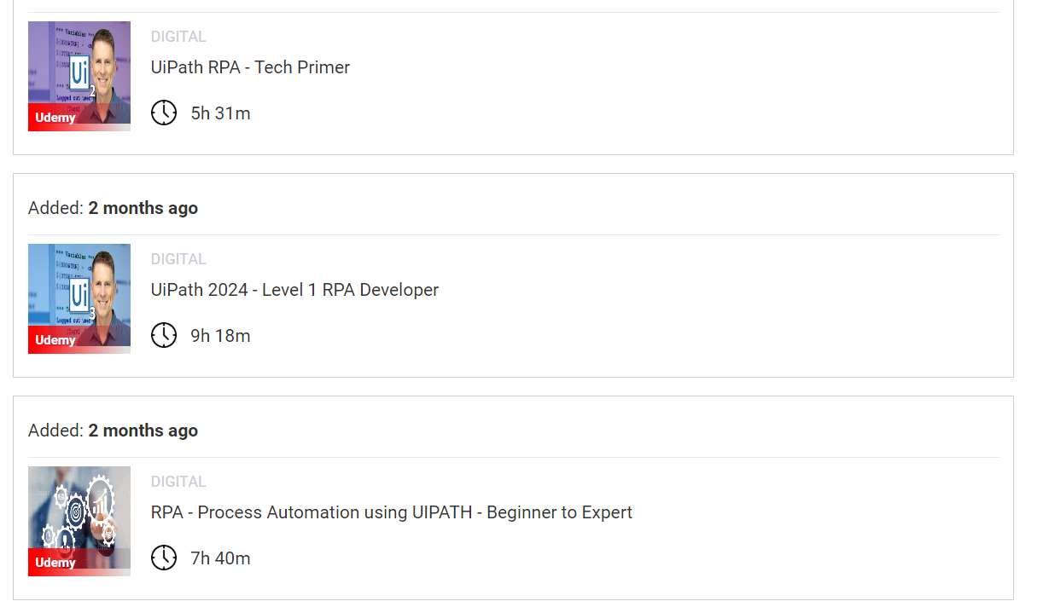
E-Learning with Udemy

